Slide 1
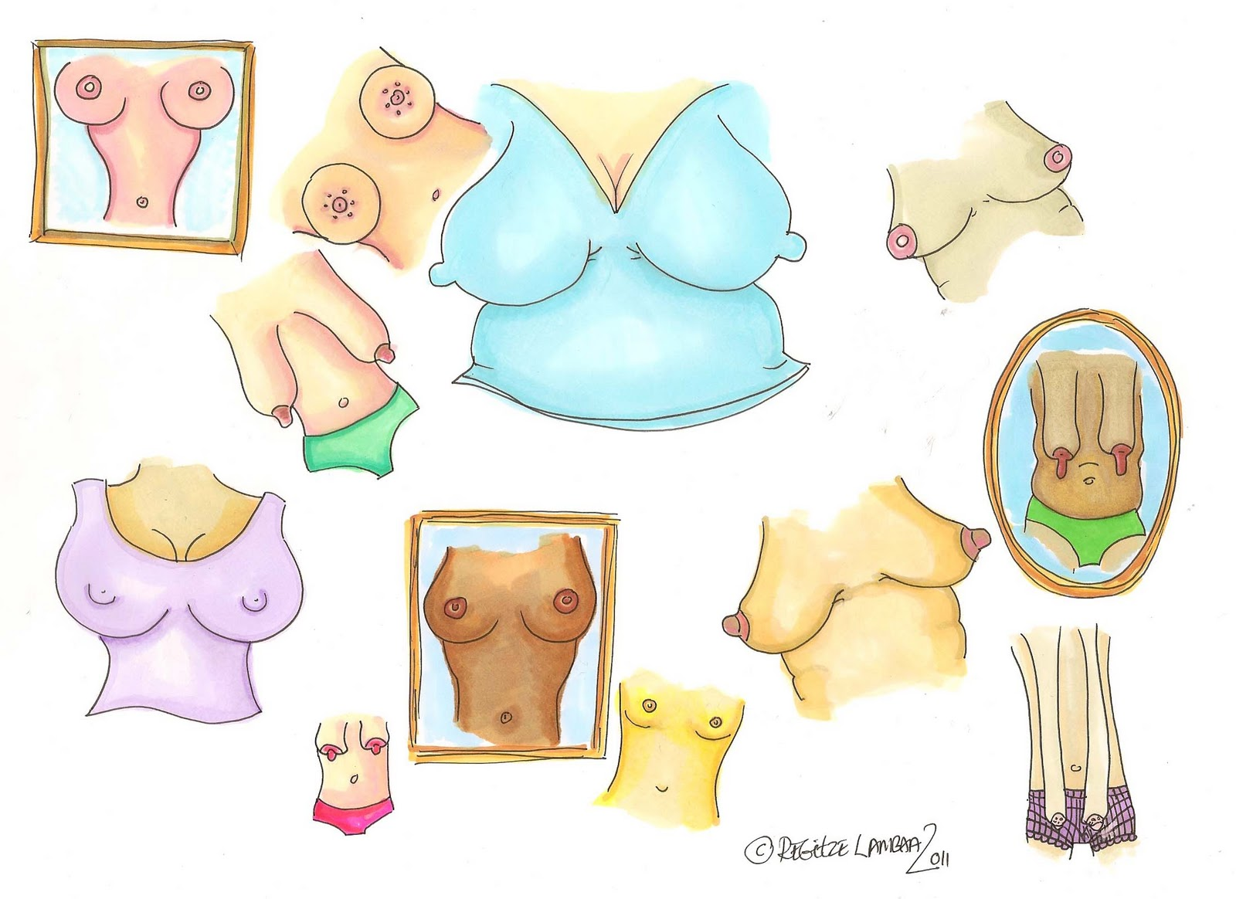
Mamma Magnitudine
Jannie Thorup Hansen 11089
&
June Richter 10871

Slide 2
Mamma Magnitudine
Jannie Thorup Hansen 11089
&
June Richter 10871

